Slide 1
Online Food Ordering System

Slide 2
Team Members:
the total strength of the team is 3 members
1. Atik Ahmed(2100290140041)
2. Mohd Wasim(2100290140085)
3. Harshit Kaushik(2100290140068)

Slide 3
Introduction
The online food ordering system is one of the latest services most fast food restaurants in the western world are adopting. With this method, food is ordered online and delivered to the customer.
So, the system designed in this project will enable customers go online and place order for their food.
One of such business that the internet introduced is an online food ordering system. In today’s age of fast food and take out, many restaurants have chosen to focus on quick preparation and speedy delivery of orders rather than offering a rich dining experience.

Slide 4
Technologies requirements
HTML(Hyper Text Markup Language)
CSS(Cascading Style Sheet)
JavaScript
Bootstrap
SQL(Database)
PHP

Slide 5
Hardware Requirements
• Hardware recommend by all the software needed.
• RAM: 256MB or more
• Hard Drive: 10 GB or more
• Communication hardware to serve client request

Slide 6
Modules Description
Module 1: Login Module In login module the customer and restaurants login will be taken while they already registered on the application. Every manager/user will have login id and password to login to the application.
• Module 2: Registration Module This module is displayed to the visitors if they need to perform some order placements, and new registration for restaurants who wants to do business with us on our online restaurant management application.
• Module 3:Add/Update/remove Menu This module is for admin. Admin have rights to insert, update (modify) and delete the data in database as per his/her necessary requirements.

Slide 7
Module 4: Payment Module: In this module user can select payment option.
Module 5: Add to cart: In this module user can add or remove items in a cart.
Module 6: Order confirmation: In this mudule user get a conformation Message of successfully order.

Slide 8
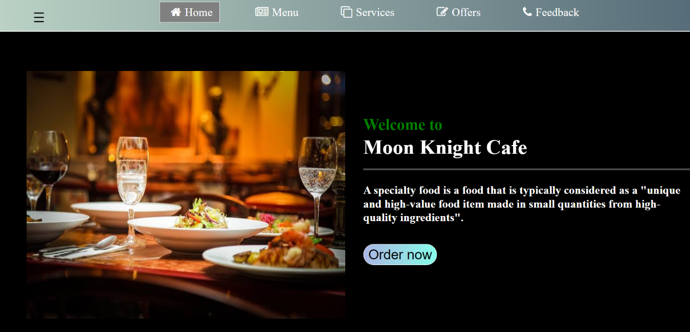
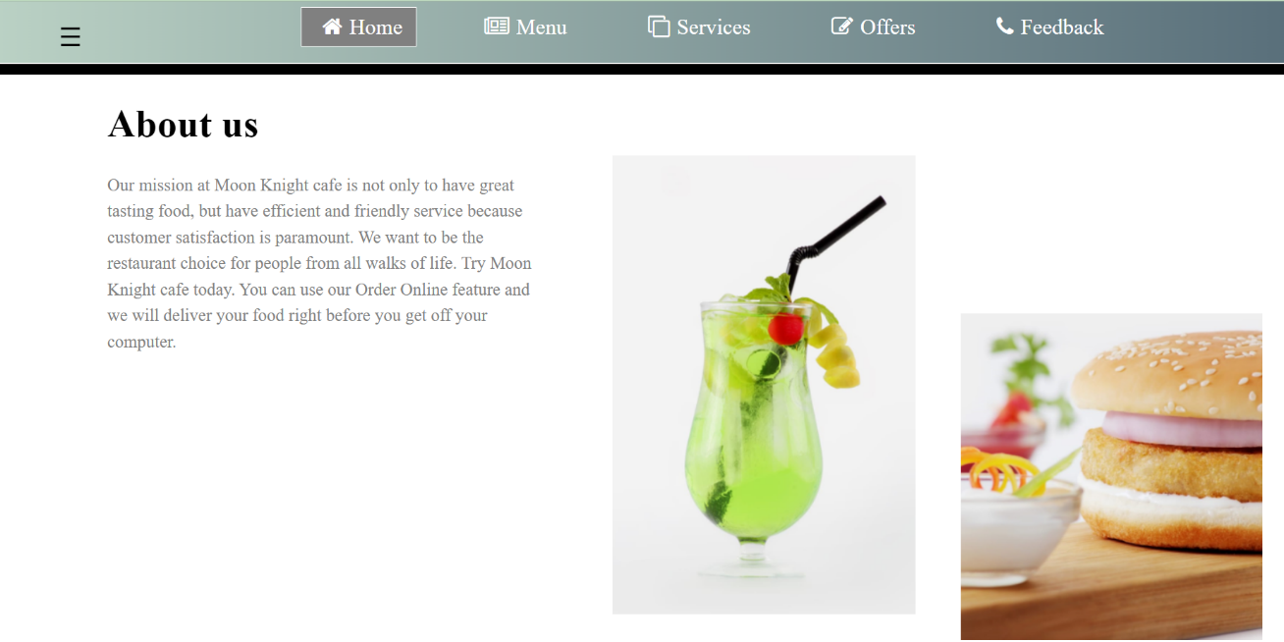
Outputs:

Slide 9
Outputs:

Slide 10
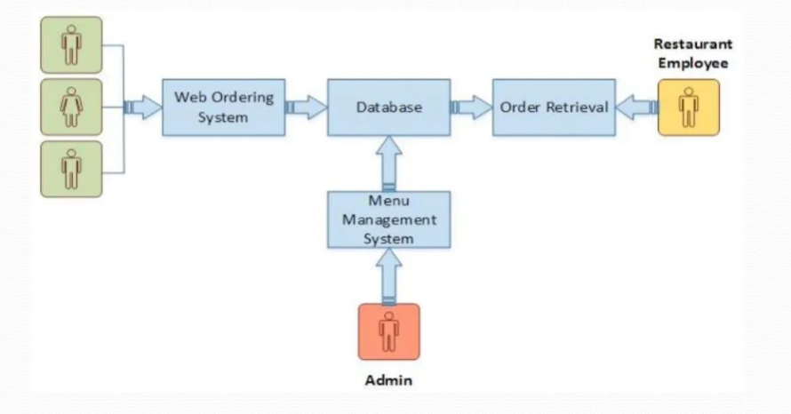
How to serve the society??
DFD of Restaurant Management System

Slide 11
Conclusion:
This is achieved through an easy to use graphical interface menu options. The users can add any number of items to the cart from any of the available food categorized by simply clicking the Add to Cart button for each item. Once item is added to the cart, user is presented with the detail order to review or continue shopping.

Slide 12


